Slide 1

Tutorial Questions （Week 7）
Haohao Li (李好好)
Southern University of Science and Technology
Email: 12432581@mail.sustech.edu.cn

Slide 2
Basic knowledge Review on Chap 3a
Fourier Analysis
Response for Complex Exponentials
Fourier Series: Synthesis Equation & Analysis Equation
Properties
Computation on ak

Slide 3
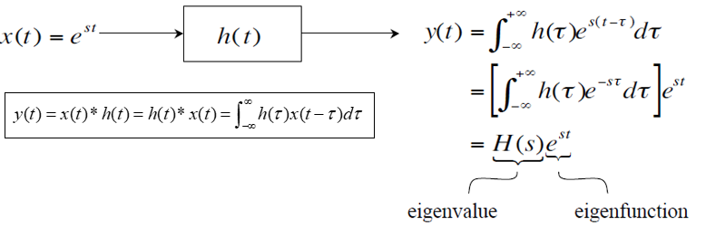
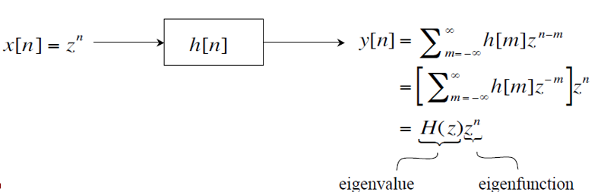
Complex Exponentials - The Only Eigenfunctions of Any LTI Systems
CT LTI systems
DT LTI systems

Slide 4
Basic knowledge Review on Chap 3a
Fourier Analysis
Response for Complex Exponentials
Fourier Series: Synthesis Equation & Analysis Equation
Properties
Computation on ak

Slide 5
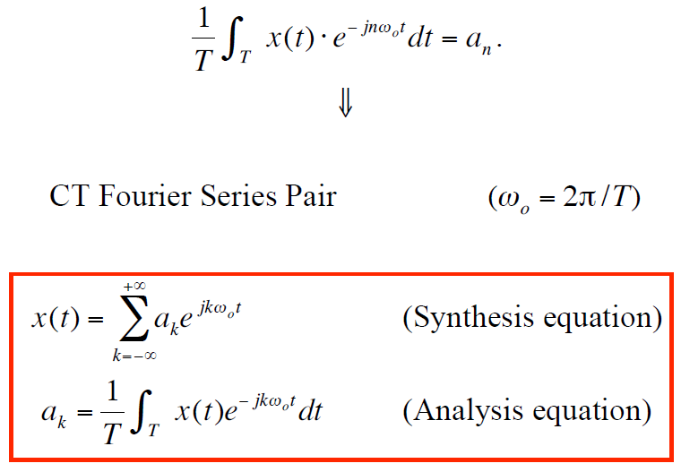
Integral
Since
Please note that (0,T) can be replaced by any interval of length T

Slide 6
Basic knowledge Review on Chap 3a
Fourier Analysis
Response for Complex Exponentials
Fourier Series: Synthesis Equation & Analysis Equation
Properties
Computation on ak

Slide 7
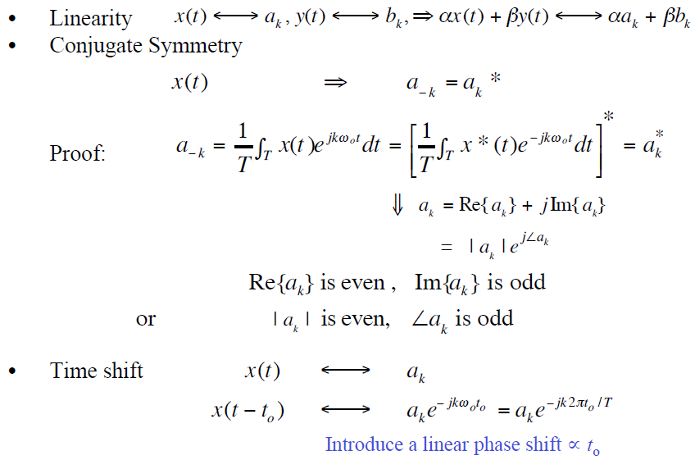
Based on the same period among x and y!

Slide 8
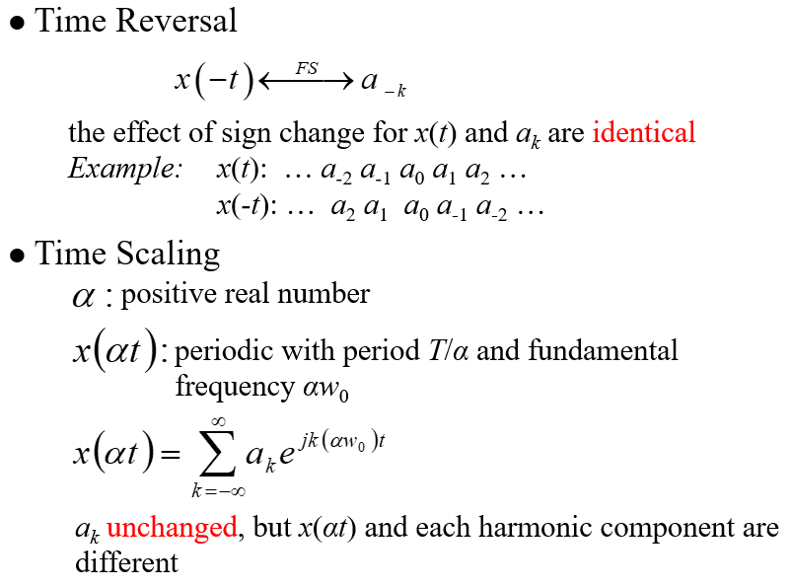

Slide 9
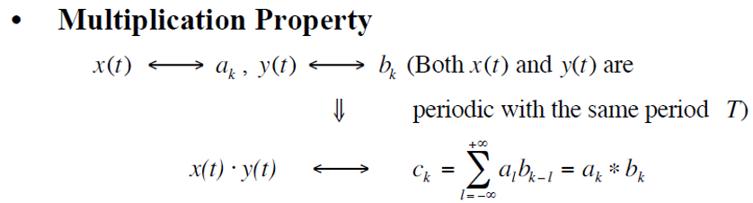
Proof

Slide 10
Parseval Relation
Observation: power is the same whether measured in the time-domain or the frequency-domain
Proof

Slide 11
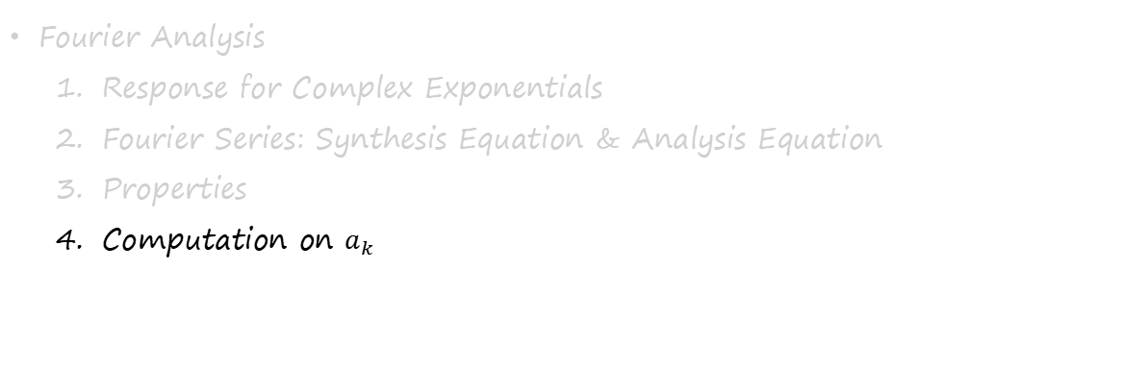
Basic knowledge Review on Chap 3a

Slide 12
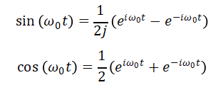
Example 1
Conjugate Symmetry

Slide 13
Example 2
Conjugate Symmetry
Please think about
Hint: You should find the period and the fundamental frequency!

Slide 14
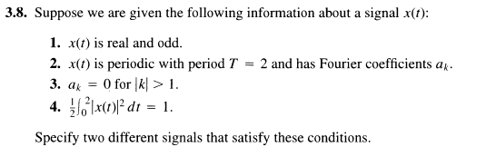

Slide 15
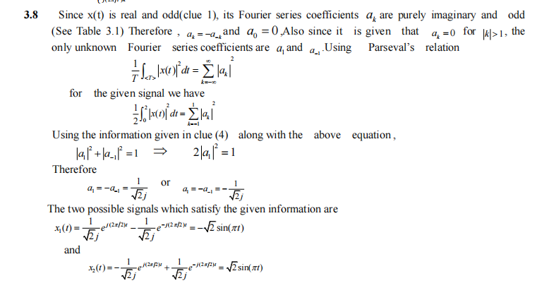

Slide 16
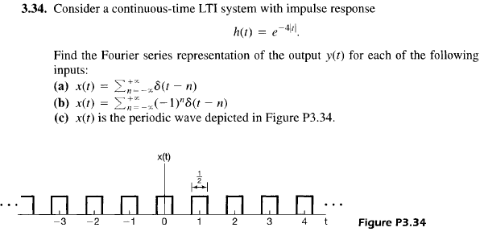

Slide 17
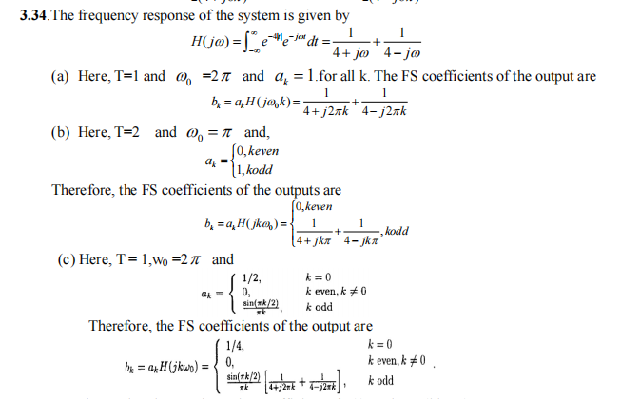

Slide 18
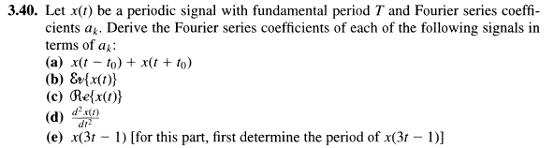

Slide 19
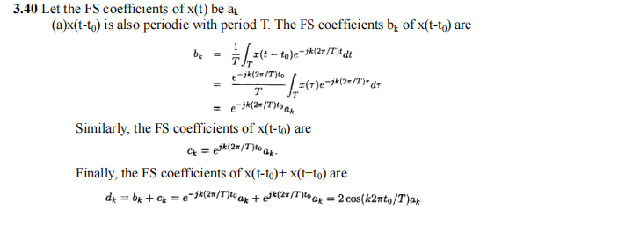
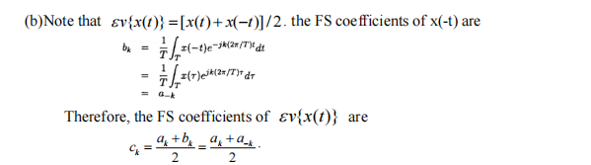

Slide 20
